Slide 1
Data Types in C

Slide 2
A Data Type
A data type is
  A set of values AND
  A set of operations on those values
A data type is used to
  Identify the type of a variable when the variable is declared
  Identify the type of the return value of a function
  Identify the type of a parameter expected by a function

Slide 3
A Data Type (continued)
When the compiler encounters a declaration for a variable, it sets up a memory location for it
An operator used on a variable or variables is legal only if
  The operator is defined in that programming language for a variable of that type
  The variable or variables involved with the operator are of the same or compatible types

Slide 4
Rules for Constructing Identifiers in C
Capital letters A-Z, lowercase letters a-z, digits 0-9, and the underscore character
First character must be a letter or underscore
Usually only the first 32 characters are significant
There can be no embedded blanks
Keywords cannot be used as identifiers
Identifiers are case sensitive
Identifiers refer to the names of data types, constants,
variables, and functions

Slide 5
Two Classifications of Data Types
Built-in data types
  Fundamental data types (int, char, double, float, void, pointer)
  Derived data types (array, string)
Programmer-defined data types
  Structure
  Union
  Enumeration

Slide 6
1. Fundamental Data Types
void – used to denote the type with no values
int – used to denote an integer type. Integer is whole number that can be negative, positive, or zero: ex. -40, 0, 200, 19339
char – used to denote a character type. Character (are enclosed by single quotes in C). All letters, numbers, and special symbols. Ex. ‘A’, ‘+’, ‘5’
float, double – used to denote a floating point type. Floating point is whole number plus a decimal part. ex. 3.14159, 1.23e45
int *, float *, char * – used to denote a pointer type, which is a memory address type.

Slide 7
2. Derived Data Types
Array – a finite sequence (or table) of variables of the same data type
String – an array of character variables. String (are enclosed by double quotes in C). Are combinations of more than one character.
  Ex. “programming”, “ME 30”
Structure – a collection of related variables of the same and/or different data types. The structure is called a record and the variables in the record are called members or fields

Slide 8
Records (Structures)
A record permits a programmer to handle a group of variables as one variable
The fields (members) of a record can be any built-in or programmer-defined data type
A record can have values assigned to and read from it just like the built-in variable types
A record can also be passed as an argument to a function and serve as the return value for a function

Slide 9
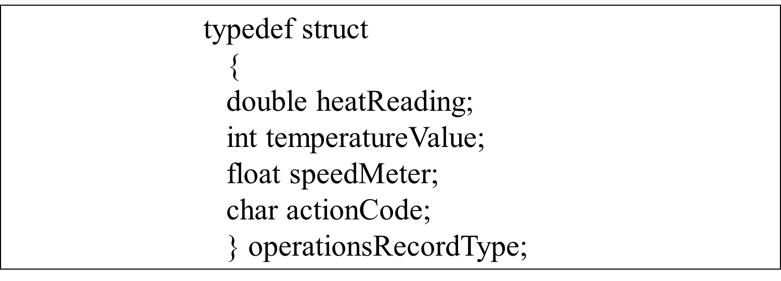
The typedef Keyword and Records
The typedef keyword can be used to create a synonym for a
data type. It is most often used to simplify the naming and
use of record types (i.e., structure types).

Slide 10
TYPEDEF
typedef - a type definition, typedef, gives a name to a data type by creating a new type that can then be used anywhere a type is permitted. The primary advantage of the type definition is that it allows you to replace a complex name that makes a program easier to read and follow. The format for the type definition is as follows:
typedef type IDENTIFIER ;
keyword
Any standard
or derived type
Traditionally
uppercase

Slide 11
TYPEDEF
The syntax is,
  typedef type-declaration the_synonym;
Names for structure types are often defined with typedef to create shorter and simpler type name.
For example, the following statements,
  typedef struct Card MyCard;
  typedef unsigned short USHORT;
Defines the new type name MyCard as a synonym for type struct Card and USHORT as a synonym for type unsigned short.
Programmers usually use typedef to define a structure (also union, enum and class) type so a structure tag is not required.
For example, the following definition.
  typedef struct{
  char *face;
  char *suit;
  } MyCard;
No tag

Slide 12
Structures
With array, we can only declare one data type per array.
For different data type, we need another array declaration.
It is single type aggregate data type.
Struct overcomes this problem by declaring composite data types which can consist different types.
A structure is a collection of related data items stored in one place and can be referenced by more than one names.
These data items are different basic data types. So, the number of bytes required to store them may also vary.
A structure type is a user-defined composite type.
It is composed of fields or members which can be different types.

Slide 13
Structure cont..d
Structure variables can be initialized. The initialization for each variable must be enclosed in braces.
Both structure types and variables follow the same scope as normal variables, as do all identifiers.
If you define a structure within a function, then you can only use it within that function.
Likewise if you define a structure outside of any function then it can be used in any place throughout your program.
Example, to store and process a student’s record with the elements chIdNum (identification number), chName, chGender and nAge, we can declare the following structure,
      struct student {
      char chIdNum[5];
      char chName[10];
      char chGender;
      int nAge;
      };
tag

Slide 14
Structure cont..d
Here, struct is a keyword that tells the compiler that a structure template is being declared and student is a tag that identifies its data structure.
Tag is not a variable; it is a label for the structure’s template.
Note that there is a semicolon after the closing curly brace.
A structure tag simply a label for the structure’s template but you name the structure tag using the same rules for naming variables.

Slide 15
How to define a structure
Compiler will not reserve memory for a structure until it is declared.
A structure declaration names a type and specifies a sequence of variable values called 'members' or 'fields' of the structure that can have different types.
An optional identifier, called a 'tag', gives the name of the structure type and can be used in subsequent references to the structure type.
A variable of that structure type holds the entire sequence defined by that type.
Declaring structure variables can be done in the following way,
  struct MyEmployee// defines a structure variable named EmpData
  { char chName[20];
  int nIdNum;
  long nDepatment;
  } EmpData;

Slide 16
Structure cont..d
The struct MyEmployee structure has three members: chName, nIdNum, and nDepatment.
The chName member is a 20-element array, and nIdNum and nDepatment are simple members with int and long types, respectively.
The identifier MyEmployee is the structure identifier.
Then we can declare variables of type struct MyEmployee like the following,
  struct MyEmployee student, staff, academician;

Slide 17
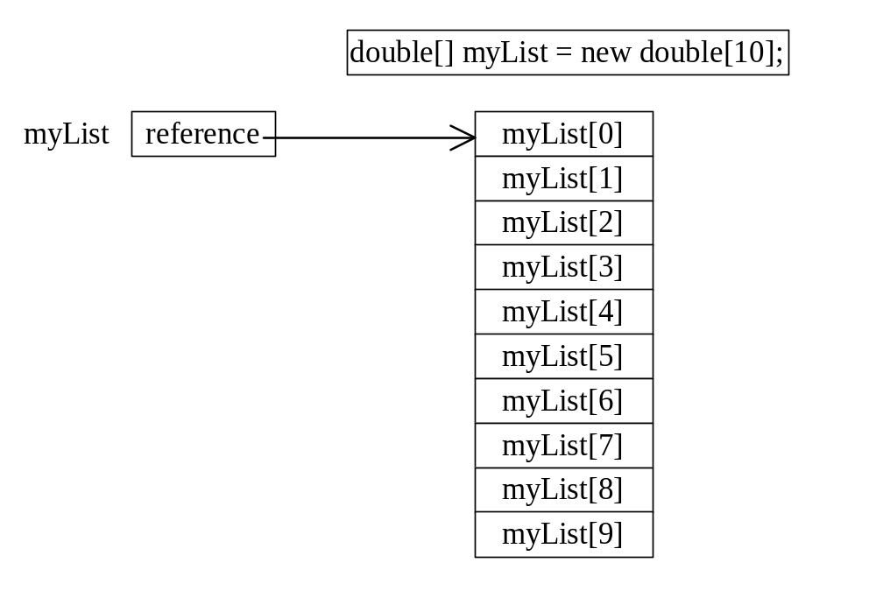
Arrays
Introduction: Array is a data structure that represents a collection of the same types of data.
An Array of 10 Elements
of type double

Slide 18
Declaring Array Variables
datatype[] arrayname;
Example:
double[] myList;
datatype arrayname[];
Example:
double myList[];

Slide 19
Creating Arrays
arrayName = new datatype[arraySize];
Example:
myList = new double[10];
myList[0] references the first element in the array.
myList[9] references the last element in the array.

Slide 20
Declaring and Creating in One Step
datatype[] arrayname = new datatype[arraySize];
Example;
double[] myList = new double[10];
datatype arrayname[] = new datatype[arraySize];
Example;
double myList[] = new double[10];

Slide 21
Initializing Arrays
Using a loop:
for (int i = 0; i < myList.length; i++)
myList[i] = i;
Declaring, creating, initializing in one step:
double[] myList = {1.9, 2.9, 3.4, 3.5};
This shorthand syntax must be in one statement.

Slide 22
Declaring, creating, initializing Using the Shorthand Notation
double[] myList = {1.9, 2.9, 3.4, 3.5};
This shorthand notation is equivalent to the following statements:
double[] myList = new double[4];
myList[0] = 1.9;
myList[1] = 2.9;
myList[2] = 3.4;
myList[3] = 3.5;

Slide 23
CAUTION
Using the shorthand notation, you have to declare, create, and initialize the array all in one statement. Splitting it would cause a syntax error. For example, the following is wrong:
double[] myList;
myList = {1.9, 2.9, 3.4, 3.5};

Slide 24
Array Applications
Given a list of test scores, determine the maximum and minimum scores.
Read in a list of student names and rearrange them in alphabetical order (sorting).
Given the height measurements of students in a class, output the names of those students who are taller than average.

Slide 25
3. Programmer-defined type
Enumeration is another user-defined type consisting of a set of named constants called enumerators.
A union is like a record But the different fields take up the same space within memory

Slide 26
ENUM – Enumeration constants
Using a keyword enum, it is a set of integer constants represented by identifiers.
The syntax is shown below;
  // for definition of enumerated type
  enum [tag] {
  enum-list
  } [declarator];
And
  // for declaration of variable of type tag
  enum tag declarator;

Slide 27
Enumeration
Enumerated types - enumerated type, enum, is built on the integer type. In an enumerated type, each integer value is given an identifier called an enumeration constant. This allows us to use symbolic names rather than numbers, which makes our programs much more readable. Once we have defined the enumerated types, we can create variables from them just as we can create variables from the standard types. Syntax:
enum tag { enumeration constants } ;
enum tag variable_identifier ;
The tag is an
enum identifier
This defines a
new enumerated type
This declares
an enumerated type
of type
tag

Slide 28
ENUM contd..
The values in an enum start with 0, unless specified otherwise, and are incremented by 1. For example, the following enumeration,
  enum days {Mon, Tue, Wed, Thu, Fri, Sat, Sun};
Creates a new data type, enum days, in which the identifiers are set automatically to the integers 0 to 6.
To number the days 1 to 7, use the following enumeration,
  enum days {Mon = 1, Tue, Wed, Thu, Fri, Sat, Sun};
Or we can re-arrange the order,
  enum days {Mon, Tue, Wed, Thu = 7, Fri, Sat, Sun};

Slide 29
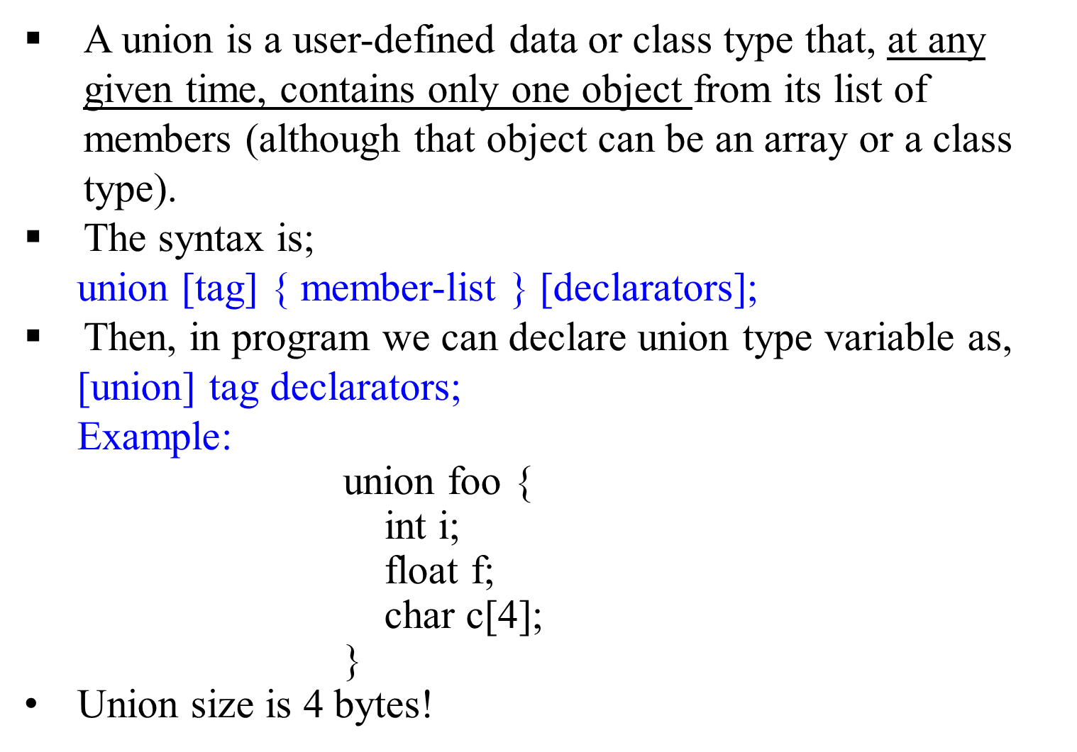
UNION

